Slide 1
CS 4530: Fundamentals of Software Engineering Module 1, Lesson 1 Course Introduction
Rob Simmons
Khoury College of Computer Sciences

Slide 2
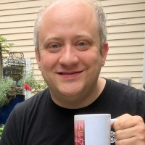
Course staff
Course Adminstration
Elizabeth O’Reilly
TAs
Apurva Sani
Chaman Kumar
Manas Aggrawal
Tanya Shukla
Anish Hedge (not here today)
Vihar Reddy (joining next week)
Me! Rob Simmons

Slide 3
Learning Objectives for this Module
By the end of this module, you should be able to:
Explain in general terms what software engineering is
List your weekly obligations as a student
List the requirements for completing the course

Slide 4
What does it mean to make software... engineering?
Wikipedia on...
Engineering
Wikipedia on...
Engineering design process
"Engineering is the practice of using natural science, mathematics, and the engineering design process to solve problems within technology, increase efficiency and productivity, and improve systems."
"Engineering is formulating a problem that can be solved through design."
Common stages:
Research
Design requirements
Feasibility
Concept generation
Preliminary design
Detailed design
Production planning
Notes:
QUESTION TIME: okay, based on what you know of history, who would have been the first to run into problems where they needed to think about software at the level of an engineering design process?

Slide 5
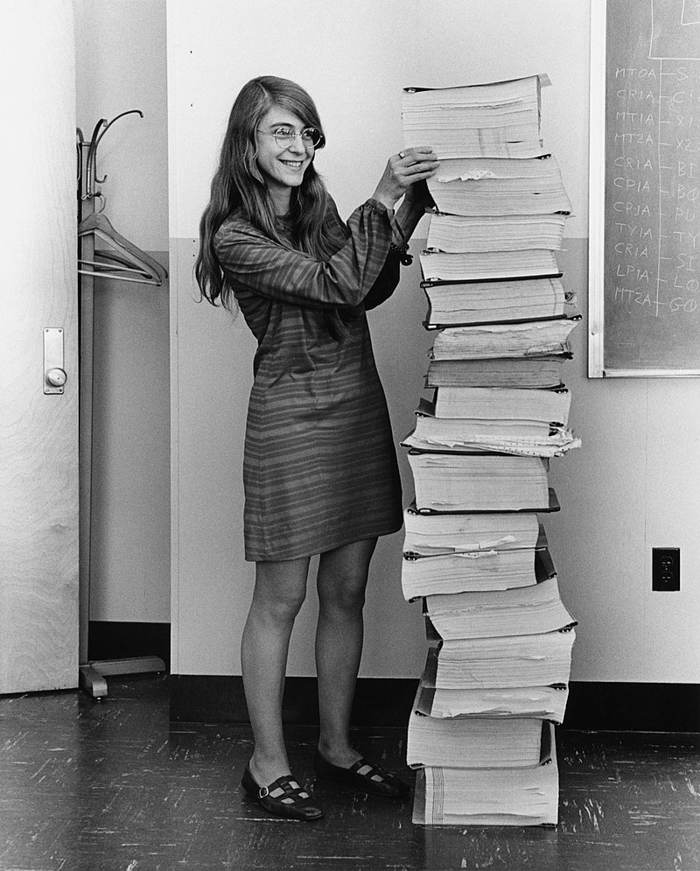
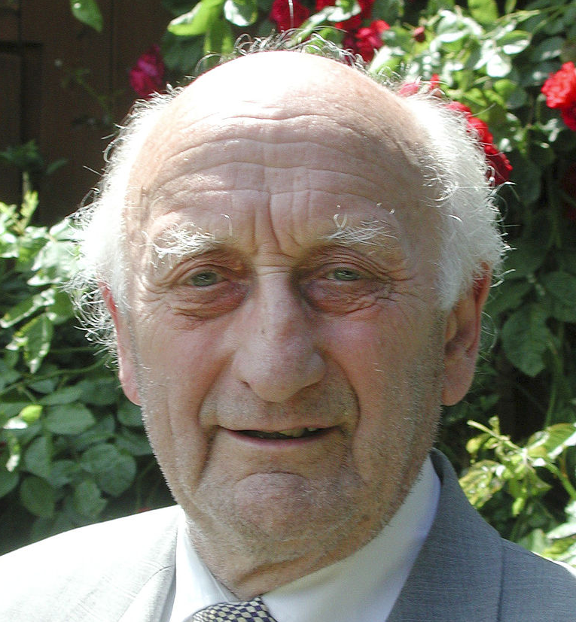
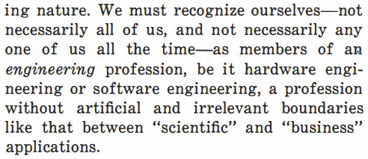
Origins of "software engineering"
Margaret Hamilton
@ NASA, around 1963
1968 NATO conference on Software Engineering + Outcomes​
The Apollo Guidance Computer's software, basically
Friedrich Bauer
Barry Boehm
Anthony Oettinger, ACM President
Comm. of the ACM,
August 1966 (page 546)
(all pictures from Wikipedia)

Slide 6
One definition of "software engineering"
Compare that with Wikipedia on...
Engineering design process
Software engineering concerns the
design
construction,
and maintenance
Common stages:
Research
Design requirements
Feasibility
Concept generation
Preliminary design
Detailed design
Production planning
of large programs
over time.

Slide 7
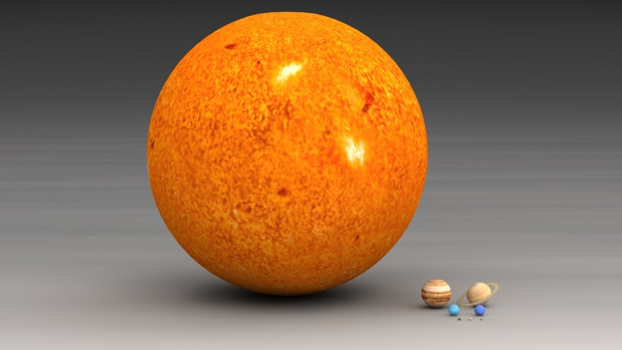
Okay, what do you mean by "large"
The Apollo Guidance Computer's software
Almost any pre-series-B startup
Your 4-person project in this class
(image from “The Scale of Space” on KWIT, March 2018)
Notes:
Wildly different notions of scale at work, and from NATO to Google, the practice of software engineering is usually defined by the biggest players!
That doesn’t mean that there aren’t problems that everyone faces.

Slide 8
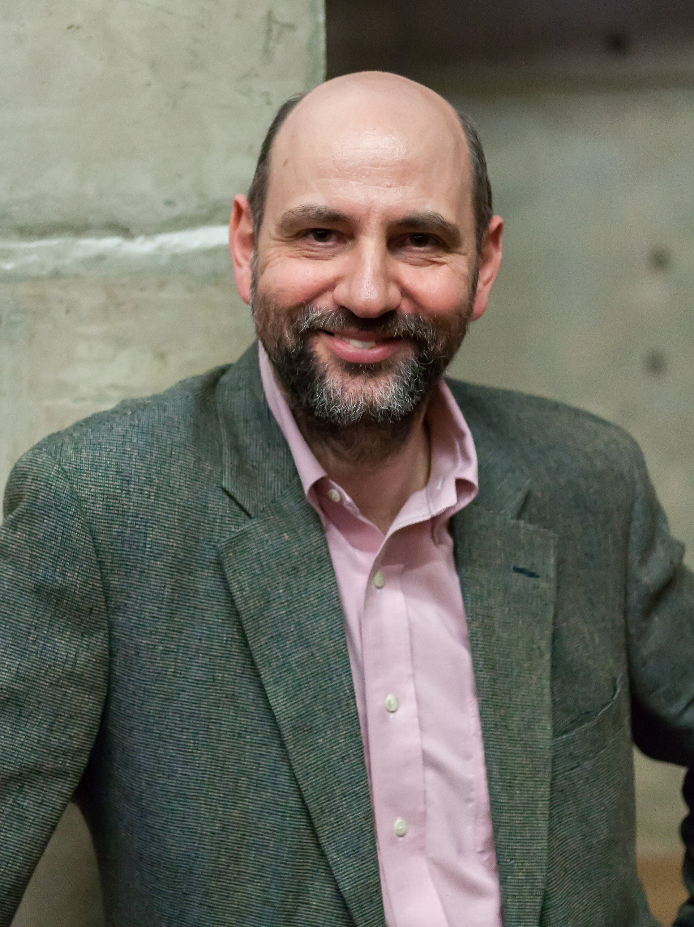
Problem 1: Programs need to be read by people
"Any fool can write code that a computer can understand. Good programmers write code that humans can understand"
Martin Fowler

Slide 9
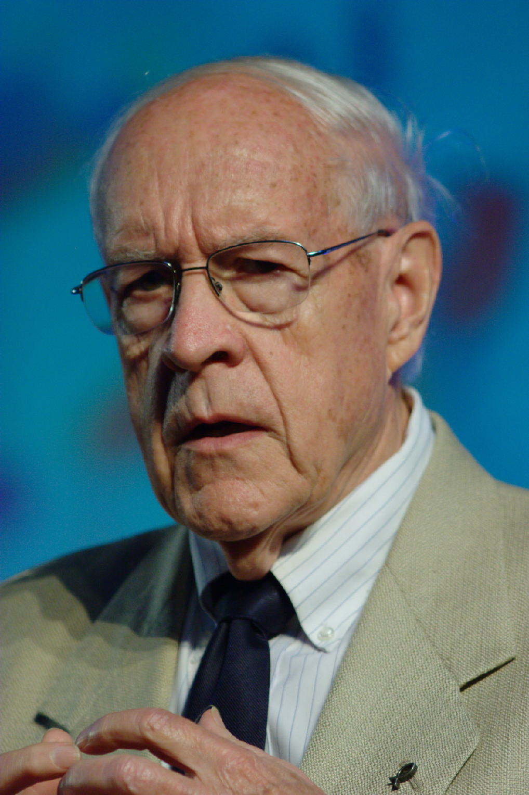
Problem #2: People need to talk to each other
"Adding manpower to a late software project makes it later"
Fred Brooks, 1975
Notes:
If you have n people on a project, you have O(n^2) potential connections between them.

Slide 10
So, software engineering must encompass:
People,
PROCESSES,
& Programs

Slide 11
The course will cover
People
how to organize software teams and make them function effectively
how software engineering teams work in larger organizations
Processes
how to divide a large project into engineering tasks
how to coordinate the tasks to form a coherent whole
Programs
how to write programs that people can understand and maintain
…focusing on a particular domain (medium-sized web applications)

Slide 12
Three Scales of Design
The Planning Scale
key questions: How do we make software artifacts “good”? What does that mean? Who decides?
The Organizational Scale
key questions: What are people’s needs? How do we design software artifacts that meets those needs?
The Implementation Scale
key question: how to design software artifacts that are easy to test, understand, and modify?

Slide 13
So, software engineering must encompass:
PLANNING,
ORGANIZING,
& IMPLEMENTING

Slide 14
So, software engineering must encompass:
PEOPLE
PROCESSES
PROGRAMS
PLANNING
ORGANIZING
implementing

Slide 15
So, software engineering must encompass:
PEOPLE
PROCESSES
PROGRAMS
mostly
out
of
scope
PLANNING
ORGANIZING
This class is here-ish
implementing
previous
classes
(OOD)

Slide 16
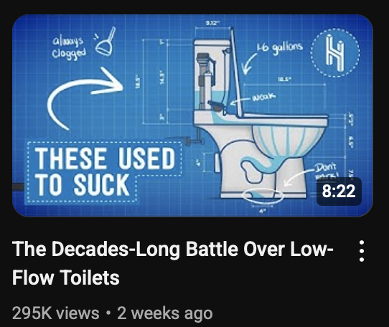
Not unique to software engineering!
PLANNING
Half as Interesting on YouTube
ORGANIZING
howstuffworks.com
implementing
Notes:
This way of thinking about engineering is not unique to software engineering. A friend who I worked with at her capacity as a designer mentioned bathrooms as a really visceral example. There are lots of implementation details: how do you make a toilet flush, or a ground-fault circuit interrupter… interrupt ground faults?

Slide 17
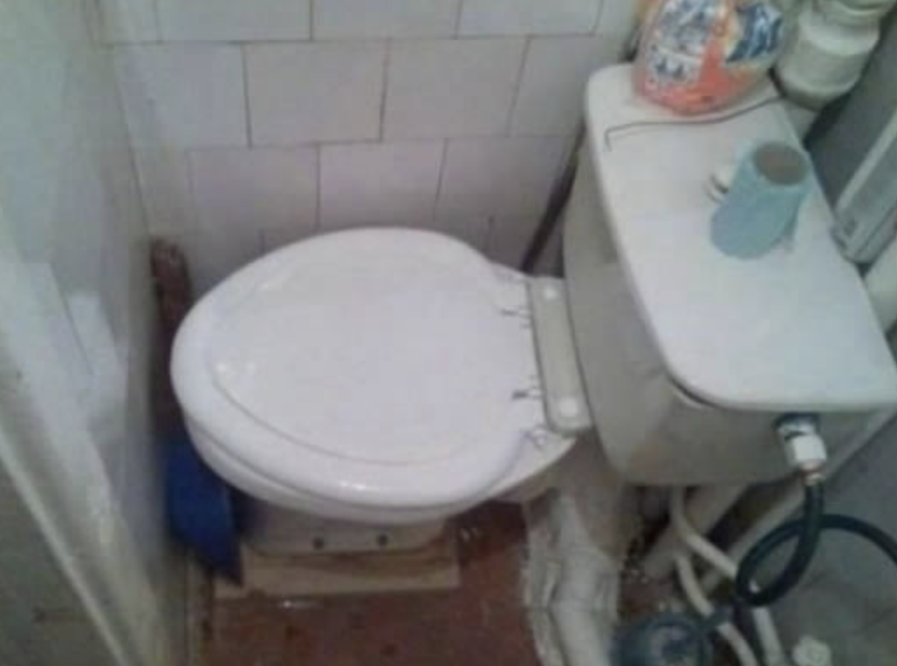
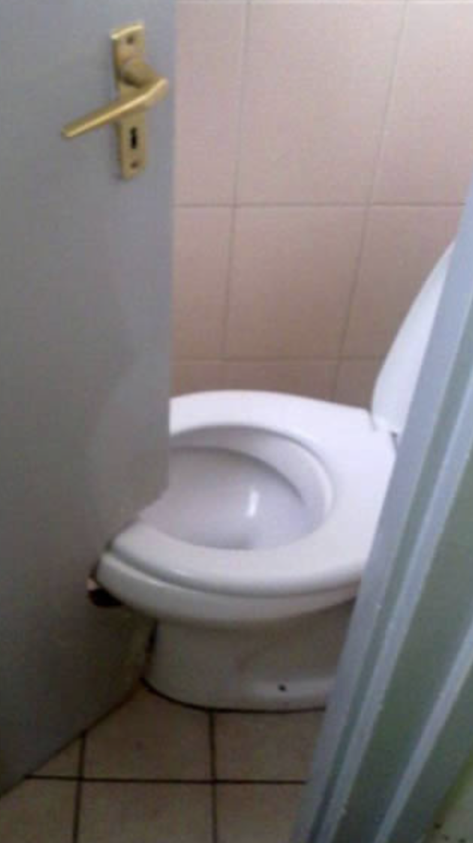
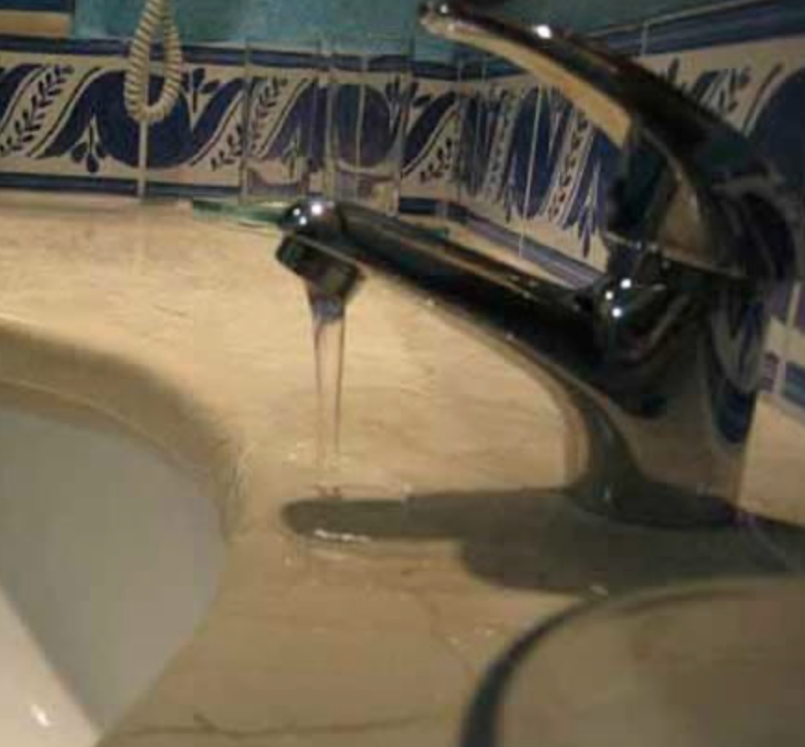
Not unique to software engineering!
PLANNING
ORGANIZING
implementing
www.oddee.com/item_97852.aspx
Notes:
Remember the organization level is about what what people’s needs are, and how we design artifacts that meet those needs. Frankly, I remembered finding a lot more funny memes of hilarious ways that bathrooms failed to meet the needs of folks. Remember, that’s what this course focuses on: making sure software meets the identified needs of human beings. Something I noticed about this was that the examples I thought of in “implementing” mostly dealt with things in isolation, whereas these examples all involve the interaction of two different components. Integration testing is something we’ll talk more about!

Slide 18
Not unique to software engineering!
PLANNING
ORGANIZING
implementing
www.architecturaldigest.com
Notes:
Okay, I’m guessing nobody here has significant architecture training, but “architecture” is the field that encompasses most of the ”planning design” aspects of building a bathroom. Nevertheless, you all know what it feels like to be in a room that welcomes you and feels good to be in. You also know what it feels like to use a software artifact that was designed merely to satisfy user needs versus a software artifact that feels good, even if it’s subjective and hard to articulate. This aspect of design is much more diffuse in computer science and software engineering; some of it is treated as public policy, some of it is the School of Public Policy, some of it is in the College of Arts, Media, and Design, and some of it is in Khoury, especially the human-computer interaction parts.

Slide 19
Not unique to software engineering!
PEOPLE
PROCESSES
PROGRAMS
Notes:
QUESTION TIME: Okay, let’s talk about this in the bathroom analogy along these columns. “Programs” here are going to need to be replaced by physical artifacts
People
how to organize software teams and make them function effectively
how software engineering teams work in larger organizations
Processes
how to divide a large project into engineering tasks
how to coordinate the tasks to form a coherent whole
Programs
how to write programs that people can understand and maintain
…focusing on a particular domain (medium-sized web applications)

Slide 20
Course outcomes
By the end of this course, you will…
…be able to define and describe the phases of the software engineering lifecycle.
…demonstrate an ability to use key processes and technologies in modern software development and be able to explain the purpose of those processes and technologies.
…be able to apply instances of major tools used for elementary software engineering tasks in the context of web applications.
…design and implement a portfolio-worthy software engineering project in a small team environment that can be showcased to recruiters.

Slide 21
Course outcomes
By the end of this course, you will…
…be able to define and describe the phases of the software engineering lifecycle.
…demonstrate an ability to use key processes and technologies in modern software development and be able to explain the purpose of those processes and technologies.
…be able to apply instances of major tools used for elementary software engineering tasks in the context of web applications.
…design and implement a portfolio-worthy software engineering project in a small team environment that can be showcased to recruiters.
These are normal learning goals for a course at a university!
This is maybe a little different

